Slide 2
Unit 1: Introduction to Simulation and Modeling (4 hrs)
1.1 System and its concepts
1.2 System Environment
1.3 Types of System (Continuous and Discrete, Static and Dynamic, Stochastic and Deterministic)
1.4 Steps of Simulation
1.5 Advantage, Disadvantage and Applications of Simulation
1.6 System Modeling and Types of Models
1.7 Principles of Modeling
1.8 Verification and Validation of Model

Slide 3
Simulation
A simulation is the imitation of the operation of a real-world process or system over time.
Simulation is used before an existing system is altered or a new system is built.
Why Simulation?
To reduce the chances of failure to meet specifications.
To eliminate unforeseen bottlenecks.
To prevent under- or over-utilization of resources.
To optimize system performance.

Slide 4
System
The term system is derived from the Greek word Systema, which means an organized relationship between functioning units or components.
It is aggregation or association of objects joined in some regular manner/interactions or independence.
The interaction/independence between the objects causes a change in the system.
E.g. Production system for manufacturing automobiles.

Slide 5
System
The system exists because it is designed to achieve one or more objectives.
There are more than a hundred definitions of the word system. Still, most seem to have a common thread that suggests that
A system is an orderly grouping of interdependent components linked to a plan to achieve a specific objective.

Slide 6
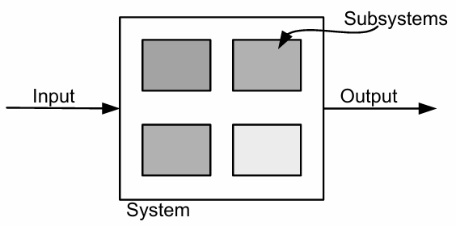
System

Slide 7
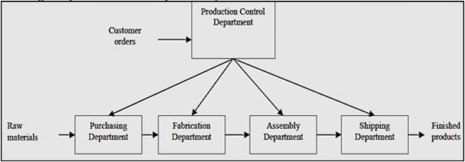
E.g. Factory System

Slide 8
Components of a System
Entity: An entity is an object of interest in a system.
Example: In the factory system, departments, orders, parts, and products are the entities.
Attribute: An attribute denotes the property of an entity.
Example: Quantities for each order, type of part, or several machines in a Department are attributes of the factory system.

Slide 9
Components of a System
Activity: Any process causing changes in a system is called an activity.
Example: Manufacturing process of the department.
Endogenous – activities/events occurring within the system.
Example: cash withdrawal from a cash counter of the bank.
Exogenous – activities occurring in the environment that affect the system.
Example: cash withdrawal from an ATM.

Slide 10
Components of a System
State of the System: The state of a system is defined as the collection of variables necessary to describe a system at any time, relative to the objective of study. In other words, the state of the system means a description of all the entities, attributes, and activities as they exist at one point in time.
Event: An event is defined as an instantaneous occurrence that may change the state of the system.

Slide 11
Components of a System
System | Entities | Attributes | Activities | Events | State Variable
Bank | Customer | Balance, Credit Status | Depositing, Withdrawal | Arrival, Departure | No. of busy tellers, No. of customers waiting
Production | Machines | Speed, Capacity | Welding, Stamping | Breakdown | State of machine (busy, idle or down)
Communication | Messages | Length, Destination | Transmitting | Arrival at destination | Number waiting to be transmitted

Slide 12
System
Other Examples Of Systems are:
Traffic System
Telephone System
Supermarket System
Transportation Operation System
Hospital Facilities System, and so on.

Slide 13
System Environment
The changes occurring outside the system that affect the system are the system environment.
Defining a system boundary is an important step
If a small system boundary is used, it may not include the necessary components
If a larger boundary is used, it may have a high degree of error propagation, management difficulties, etc.

Slide 14
Types of System
Closed System: If any system shows endogenous activity, then the system is said to be a closed system. A closed system is one where there is no interaction between the environment and the system components.
Example: Amount transferred from person A to B within the same bank.
Open System: If any system shows exogenous activity, then the system is said to be an open system. The term exogenous is used to describe the activity in the environment that affects the system.
Example: Transaction from person A to B within different banks.

Slide 15
Types of System
Discrete System: Those systems whose state variable changes instantly at separate points in time.
Example: Bank System. State variable: Number of customers.
Continuous System: Those systems whose state variables change continuously concerning time.
Example: Aeroplane moving through the air. State variable: position and velocity.

Slide 16
Types of System
Static System: Those systems which is represented at a single (specific) point in time, i.e., no time dependency.
Example: Profit-loss Analysis System.
Dynamic System: Those systems which is represented over time, i.e., time-based behaviour.
Example: Traffic simulation

Slide 17
Types of System
Deterministic System: If the outcome of the system can be described in terms of the input (in terms of some mathematical function/formulae).
Here, Behaviour is fully predictable; no randomness is involved.
Stochastic System: When the effect (outcome) of the system varies over possible outcomes (can’t be predicted using some mathematical function).
Here, Outcomes are not fully predictable; includes randomness or uncertainty.

Slide 18
Aspect | System Type | Explanation
Student enrollment | Discrete | Students enroll one by one at specific points in time (e.g., semester start).
Student performance over semester | Continuous | Performance (e.g., GPA) changes gradually with assignments and exams.
Attendance report for a day | Static | A snapshot report showing student attendance for a specific date.
Academic progression through years | Dynamic | Tracks student performance, attendance, and credit completion over time.
Grade calculation formula | Deterministic | A fixed rule (e.g., average of marks) gives the same result every time.
Predicting dropout risk | Stochastic | Based on probability using factors like attendance, grades, and engagement.

Slide 19
Steps of Simulation
Problem Formulation – Understand objectives and define scope.
Model Design – Build a conceptual or mathematical model.
Input Data Collection – Gather real-world data (often includes randomness).
Model Translation – Code the model using simulation software.
Verification – Ensure the model is implemented correctly.
Validation – Ensure the model accurately reflects the real system.
Experimentation – Run the model and analyze outcomes.
Result Interpretation & Documentation – Draw conclusions and recommend actions.

Slide 20
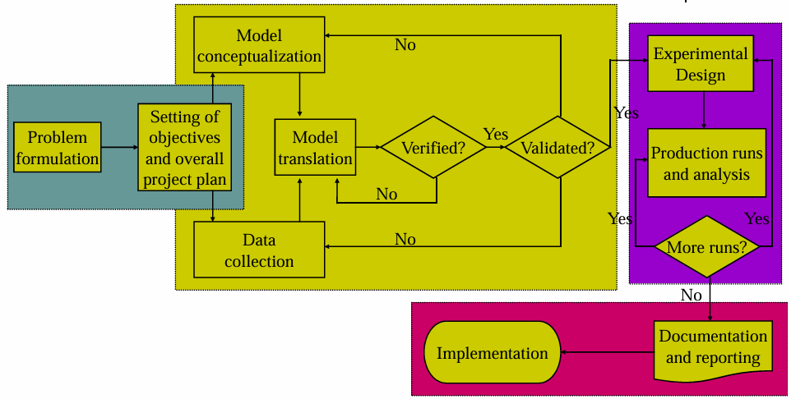
Steps of Simulation

Slide 21
Advantages of Simulation
Allows risk-free testing of new ideas
Helps in decision-making
Reveals bottlenecks and inefficiencies
Useful when real experimentation is expensive or impossible

Slide 22
Disadvantages of Simulation
Can be time-consuming and costly
Requires specialized skills
No exact solution, only approximations
Models may become too complex

Slide 23
Applications of Simulation
Manufacturing – Assembly line optimizations
Healthcare – ER patient flow modeling
Banking – ATM or teller queue analysis
Traffic – Intersection light timing
Military – Battle simulations and training
Aviation – Flight training simulators
Retail – Inventory and supply chain modeling

Slide 24
End of Lecture 2

Slide 25
System Modeling

